Slide 1
EyeSite see like you’ve never seen before.
Presented to you by The Visionaries
Denise Kutnick, Miguel Botet, Aastha Dave, Dimitri DeBarnes, Eric Fortes, and Ryan O’Connor

Slide 2
Meet The Visionaries
Denise Kutnick, Project Manager and Android Developer
Miguel Botet, Front-End Developer
Aastha Dave, Quality Assurance
Dimitri DeBarnes, Back-End Developer
Eric Fortes, Windows Developer
Ryan O’Connor, Full Stack Developer

Slide 3
What is EyeSite?
EyeSite is a system designed to make viewing text on mobile devices as easy as 1, 2, 3!
Take the EyeSite Vision Examination
Uses the same vision test algorithm that doctors use
Download EyeSite to your mobile device
Available for devices running Windows and Android
Install your personalized EyeSite font to your system
Manipulates font weight and width to accommodate everyone’s different vision perception

Slide 4
User Requirements
Device: Windows/Android
Internet Access
Web Browser
JavaScript
Terms and Conditions.
Questions
Results
Download Application

Slide 5
Functional Requirements
Provide Vision Test
Analyze Vision Test Results
Make Application Available for Download
Install Application
Preview Font
Install Font
Revert Changes (optional)

Slide 6
Architecture Patterns
Website
Thin Client
Client-Server
Windows
Layered Architecture
Android
Layered Architecture
Presentation-Logic-Data

Slide 7
Architecture – Website

Slide 8
Architecture – Windows Application

Slide 9
Architecture – Android Application

Slide 10
Dependability
Availability
Increments are tested before release
Focus Groups
Stress Tests
Automated Silk Tests
Reliability
Software is continuously tested
Weekly automated tests
Maintainability
Any abnormalities in each test are examined and fixed by the development team

Slide 11
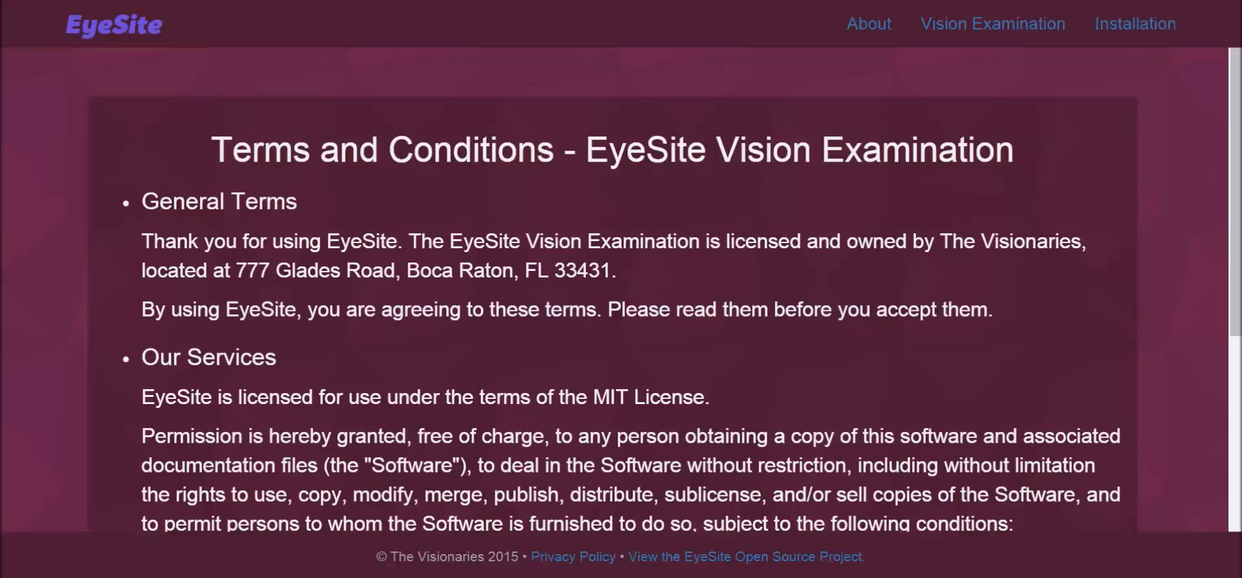
Desktop Demo

Slide 12
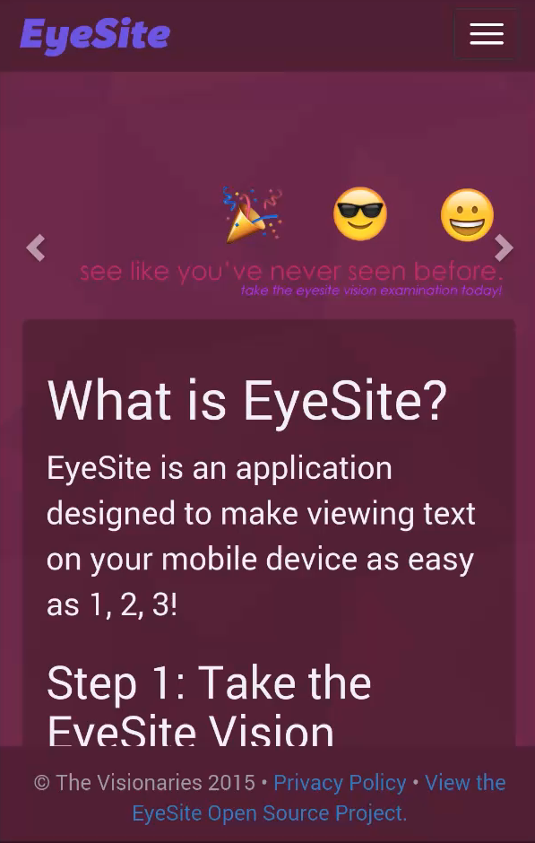
Mobile Demo

Slide 13
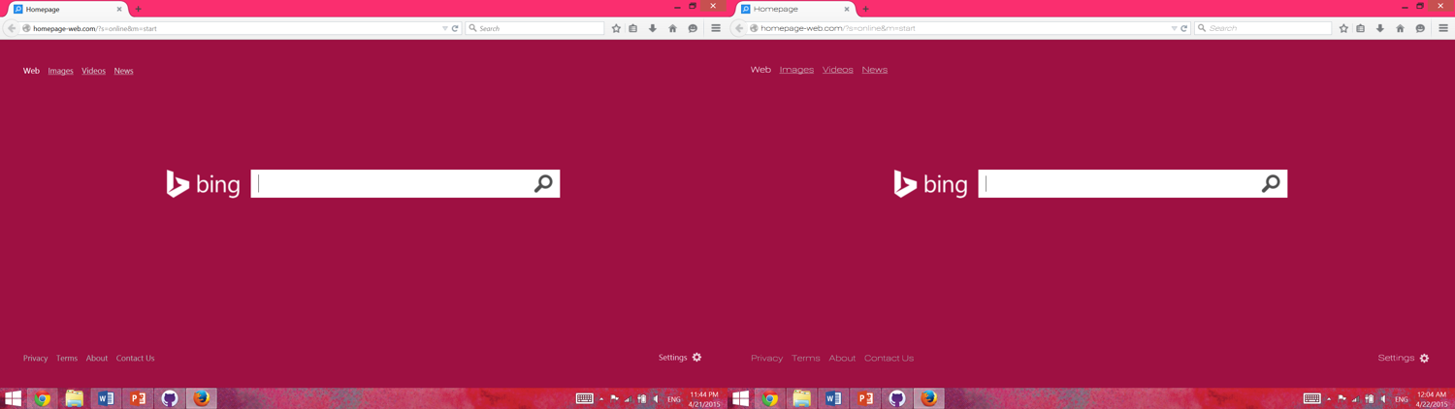
EyeSite in Action – See the Difference
Before EyeSite
After EyeSite

Slide 14
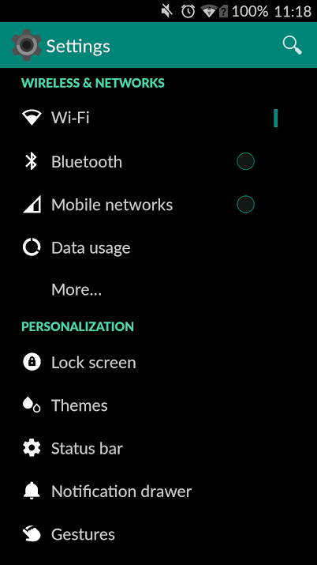
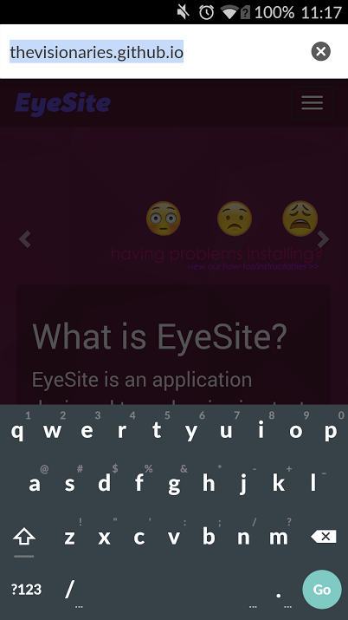
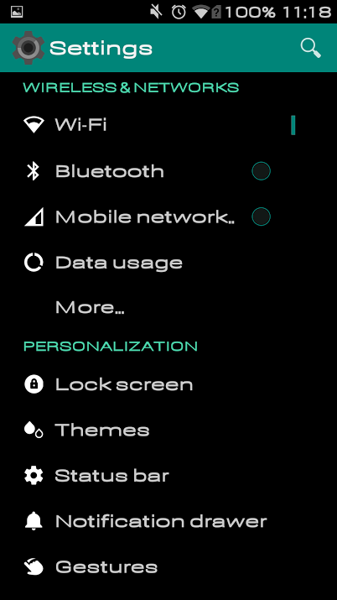
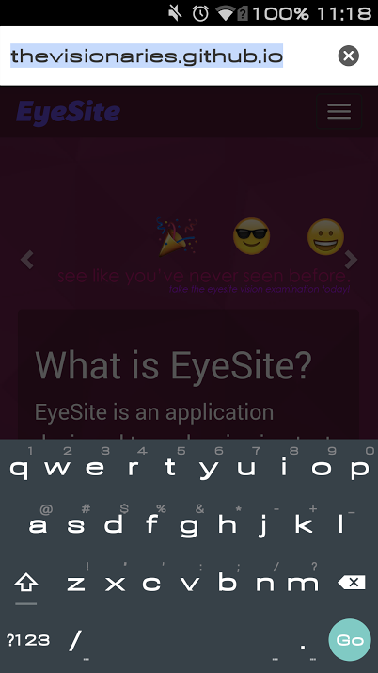
EyeSite in Action – Continued
Before EyeSite
After EyeSite

Slide 15
EyeSite Fonts – Envision the Difference
EyeSite-101 | EyeSite-102 | EyeSite-103 | EyeSite-104 | EyeSite-105 | EyeSite-106
EyeSite-201 | EyeSite-202 | EyeSite-203 | EyeSite-204 | EyeSite-205 | EyeSite-206
EyeSite-301 | EyeSite-302 | EyeSite-303 | EyeSite-304 | EyeSite-305 | EyeSite-306
EyeSite-401 | EyeSite-402 | EyeSite-403 | EyeSite-404 | EyeSite-405 | EyeSite-406
EyeSite-501 | EyeSite-502 | EyeSite-503 | EyeSite-504 | EyeSite-505 | EyeSite-506
EyeSite-601 | EyeSite-602 | EyeSite-603 | EyeSite-604 | EyeSite-605 | EyeSite-606
EyeSite-701 | EyeSite-702 | EyeSite-703 | EyeSite-704 | EyeSite-705 | EyeSite-706
EyeSite-801 | EyeSite-802 | EyeSite-803 | EyeSite-804 | EyeSite-805 | EyeSite-806
EyeSite-901 | EyeSite-902 | EyeSite-903 | EyeSite-904 | EyeSite-905 | EyeSite-906
EyeSite-1001 | EyeSite-1002 | EyeSite-1003 | EyeSite-1004 | EyeSite-1005 | EyeSite-1006

Slide 16
We judge with our eyes, and this presentation was made with our very own EyeSite-503. Thanks for looking at Eyesite!
Love,
The Visionaries

